Slide 1
STUDENT MANAGEMENT SYSTEM
Presented By
>- SURESH KARPUNETHAM

Slide 2
What is SMS ..??
Student Management System is a Full stack application developed to maintain the details of Student in any College or school.
It maintains the personal and official details of Student.
This project is used to simplify the task of maintaining records of
Students of the company.

Slide 3
Functionalities
Records are maintained in the database.
Create new users to the system accordingly.
We can search and update the user details in the database.
Maintains the records and also backup of database for a longer time.

Slide 4



Technologies Used
Angular framework for frontend development.
Spring boot + MySQL for backend development.

Slide 5


Programming Languages
HTML5, CSS3, TypeScript for frontend.
Java for backend Development.
SQL for Database.

Slide 6
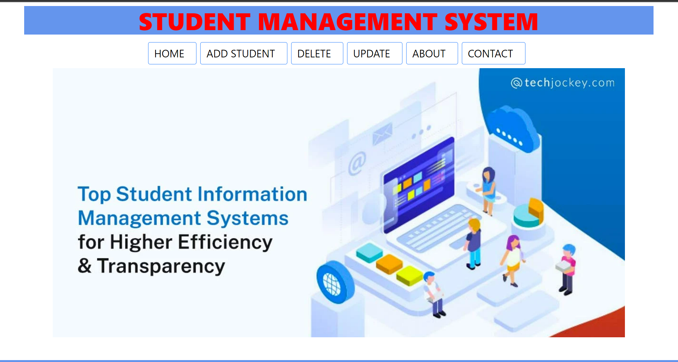
Home page

Slide 7
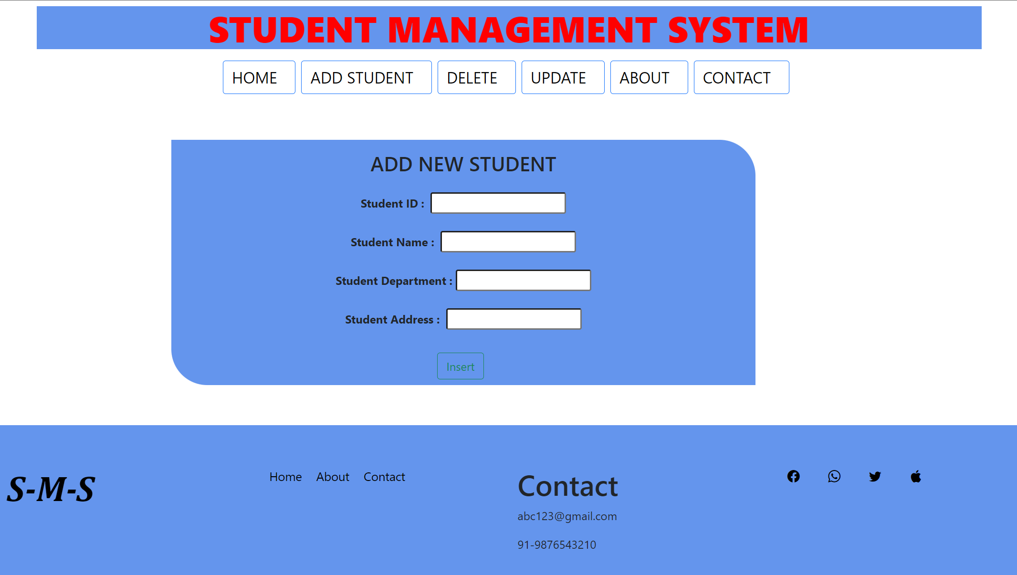
Insert new STUDENT

Slide 8
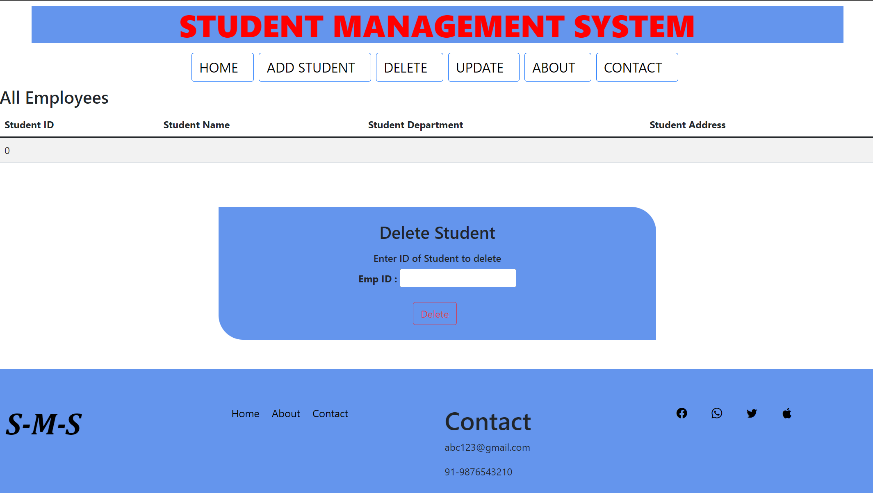
VIEW and delete STUDENTS

Slide 9
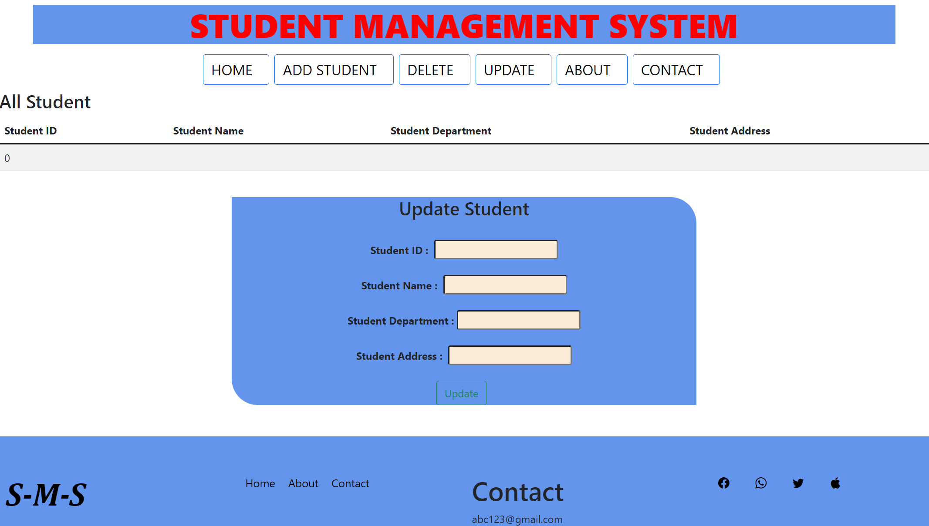
Update STUDENT

Slide 10
Thank you!

